Slide 1
Connecting to Datasets Through Python APIs and SASpy
Joe Matise
NORC at the University of Chicago

Slide 2
Introduction
Concepts covered:
Connecting to public data sources
Why Python?
Connecting Python to SAS via SASPY
Tools needed to install
Walkthrough of a data pull

Slide 3
Connecting to public data sources
Many public data sources have APIs to pull data with
API: Application Programming Interface
Most APIs are platform-agnostic
Can use SAS directly to connect
Data step with LIBNAME URL
PROC HTTP
APIs usually require significant work to obtain data in usable format

Slide 4
Why Python?
Open source language with many custom-written libraries
Powerful language; closer to SAS syntax
Many public data source APIs have python implementations available
Easy to connect to SAS

Slide 5
Installing Python
Anaconda3
https://conda.io/docs/user-guide/install/download.html
Anaconda is a custom python package specifically designed for data science
Includes many popular packages, including NUMPY, PANDAS, etc.
Make sure to configure the PATH variable in Windows
PATH is how Windows knows where to find programs
Add the python root directory and \scripts to the user path

Slide 6
Installing add-ins
pip - used for installing packages
saspy – SAS/Python interface
saskernel – if you want to use Jupyter Notebook
git – if you want to install packages directly from github
Your API packages!

Slide 7
Configure SASPY
https://sassoftware.github.io/saspy/install.html
pip install saspy , or pip install git+https://github.com/sassoftware/saspy (req. git)
Copy SASConfig.py to SASConfig_personal.py
Modify SAS_config_names to the value you plan to use (below is for local SAS):
SAS_config_names=['winlocal']
If you use server SAS, use the appropriate iom configuration, and configure your iomhost
winiomlinux = {'java' : 'java',
'iomhost' : 'linux.iom.host',
'iomport' : 8591,
'encoding' : 'latin1',
'classpath' : cpW
}
Add to your PATH the path to the sspiauth.dll file

Slide 8
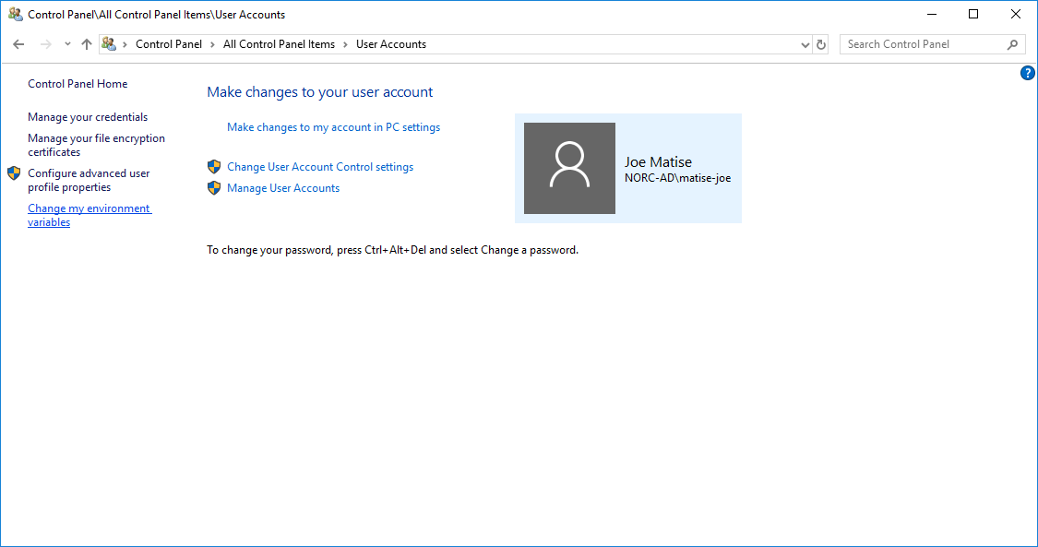
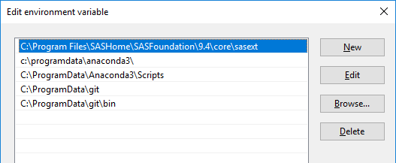
Adding to your Path
User Accounts Control Panel
Change my environment variables
Select Path -> Edit
New -> add path

Slide 9
Python Basics
Python basics
‘import’
Indenting matters!
Case Sensitive!!
‘def’ for functions
List {1,2,3}, Dictionary [‘a’:’1’, ‘b’:’2’, ‘c’:’3’] , DataFrame
List comprehension (think ‘do over’)
\\your\\paths\\need\\two\\backslashes (unless you’re in unix!)
Find a python IDE you’re comfortable with
Visual Studio Code
PyCharm
Command line
You don’t need to be a Python Wizard to do this!

Slide 10
Jupyter Notebook
Easy way to write code and reports together
Support for python directly (“pyt” in “jupyter” – “JUlia,PYThon,R”)
Comes with Anaconda, if you installed that version of Python
To add SAS support, simply run “pip install sas_kernel“
To run, open a cmd window and type “jupyter notebook”

Slide 11
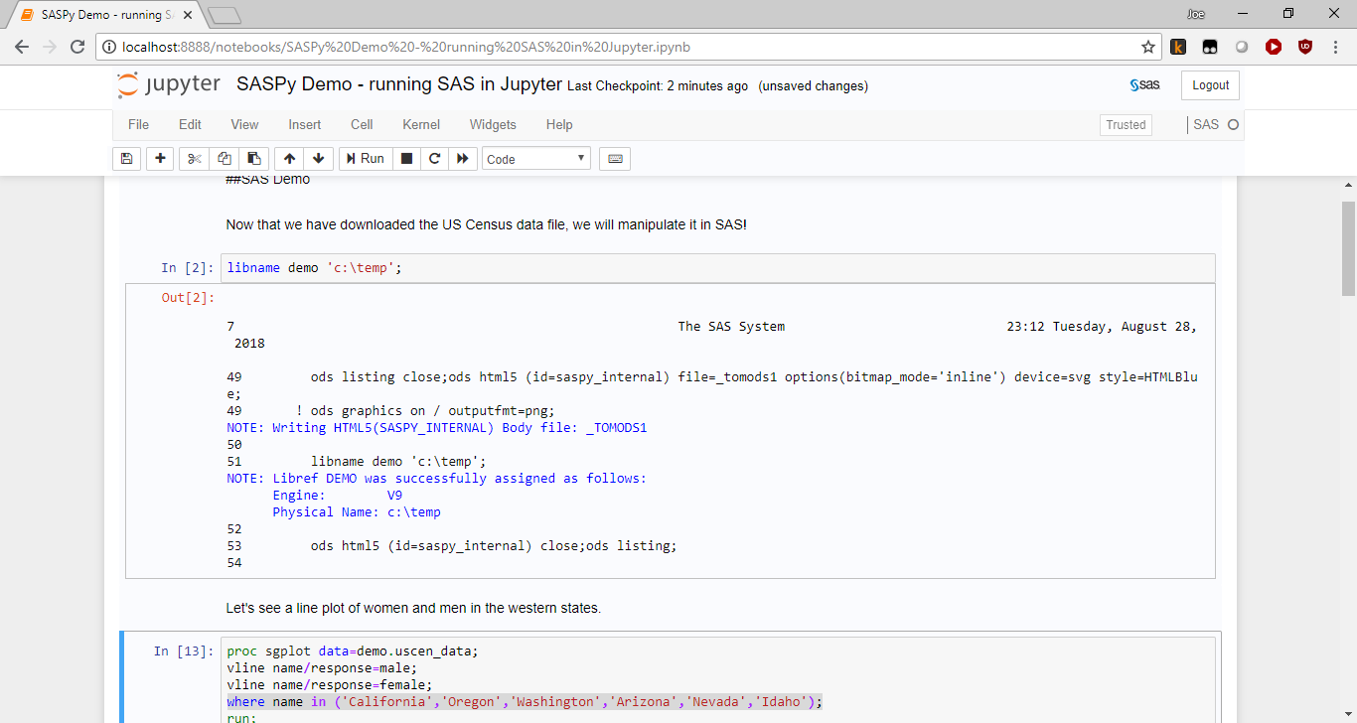

Slide 12
Testing saspy
import saspy
import pandas as pd
sas = saspy.SASsession(cfgname='winlocal')
cars = sas.sasdata("CARS","SASHELP")
cars.describe()

Slide 13
STATCAN datasets
Statistics Canada public api: Web Data Service
https://www.statcan.gc.ca/eng/developers/wds
Python API – no official API implementation?
Open source developer - https://github.com/ianepreston/stats_can/
In development
Great example for learning more!
Need to know the table number you want to download
https://www150.statcan.gc.ca/n1/en/type/data

Slide 14
Demo – Stats Can
import stats_can
import pandas as pd
import saspy
#Download the table we are interested in to a dataframe
statcan_dat =stats_can.table_to_dataframe({'17100005'},path='c:\\temp\\stats-can')
#now, upload to SAS (using a custom upload_to_sas function)
upload_to_SAS(df=statcan_dat,path='c:\\temp',sastbl='statcan_data')

Slide 15
U.S. Census
Similar to Statistics Canada
Table based, need to know table number
More well developed Python API
Actually, many!
https://github.com/datamade/census -simple query API
https://pypi.org/project/cenpy/0.9.1/ - more advanced, complicated
Need an API Key (Free!)
https://api.census.gov/data/key_signup.html

Slide 16
Demo – US Census
from us import states
from census import Census
import pandas as pd
import saspy
#First, define a connection using our API key c = Census("e7cd51b9bf8678c6e1c9944116f0984b44cded26")
#Download a couple of census questions
cen_data = pd.DataFrame(c.acs5.state(('NAME','B01001_002E','B01001_026E'), Census.ALL))
#now, upload to SAS
upload_to_SAS(df=cen_data,path='c:\\temp',sastbl='uscen_data')

Slide 17
Running SAS in Python
Reference: https://sassoftware.github.io/saspy/getting-started.html
Many SAS language elements are exposed in Python
For those that are not, can use submit()
I find this easiest to run in Jupyter
Easily integrates output
Easy to run bits at a time

Slide 18
Demo – SAS in Python
sas =saspy.SASsession(cfgname='winlocal')
#Define the libname
sas.saslib('demo',path='c:\\temp')
#Assign a dataset to a variable
cd = sas.sasdata('uscen_data','demo')
#Get the proc contents and the first few rows
cd.columnInfo()
cd.head()
#Now, fix up the labels and varnames
#(cont...)
rc = sas.submit("""
proc datasets lib=demo;
modify uscen_data;
rename b01001_002E = male
b01001_026E = female;
run;
label male="Population of males in state"
female="Population of females in state";
run; quit;
""")
HTML(rc['LOG'])

Slide 19
Running SAS in Jupyter
Jupyter notebooks are specific to one “kernel”
Create a new notebook, specifying SAS kernel
Hook up the libnames, and write SAS code

Slide 20
SAS in Jupyter Demo
libname demo 'c:\temp';
data uscen_data_pct;
set demo.uscen_data;
female_pct = female/(male+female);
run;
proc sgplot data=uscen_data_pct;
yaxis min=0.45 max=0.55;
vbar name/response=female_pct datalabel;
where name in ('California','Oregon','Washington','Arizona','Nevada', 'Idaho','Utah','Wyoming','Montana');
run;

Slide 21
Other resources
Google BigQuery
https://cloud.google.com/bigquery/docs/reference/libraries
Kaggle
https://github.com/Kaggle/kaggle-api
Github
Best place to search for APIs
CKAN
Popular metadata repository to indicate where to obtain datasets
More info and worked example in appendix

Slide 22
Questions?
Author contact info:
Joe Matise
matisejoe@gmail.com
https://github.com/snoopy369?tab=repositories
Find me on:
SAS-L (sas-l@listserv.uga.edu)
Stack Overflow (www.stackoverflow.com)

Slide 23
Appendix

Slide 24
CKAN
What is CKAN?
API for metadata about datasets
Does not directly host/return datasets
Used by many major governmental agencies
Using CKAN
Connect to host
Identify the organization/group/etc. whose data you want to search
Identify the package(s) you want to download
Obtain the URL for that dataset
Python package: CKANAPI
https://github.com/ckan/ckanapi

Slide 25
Demo - CKAN
from ckanapi import RemoteCKAN, NotAuthorized
from pprint import pprint
import pandas
import saspy
demo = RemoteCKAN('https://open.canada.ca/data/en/')
packages =demo.action.organization_show(id='elections',include_datasets=True)

Slide 26
Demo – get_urls (CKAN)
def get_urls(packages,items=['name','url','package_id']):
package_urls= []
for _package in packages['packages']:
dataset = demo.action.package_show(id=_package['id'])
for item in dataset['resources']:
package_urls.append({k:item[k] for k in (items)})
return package_urls
urls = pandas.DataFrame(get_urls(packages))

Slide 27
Demo – upload_to_SAS
def upload_to_SAS(df,path,sastbl):
sas = saspy.SASsession(cfgname='winlocal')
sas.saslib('demo',path=path)
sas.df2sd(df=df,table=sastbl,libref='demo')
upload_to_SAS(df=urls,path='c:\\temp',sastbl='url_sas')

Slide 28
CKAN – Next Steps
Can download the datasets in Python or SAS (sometimes)
Print URLs, then follow in web browser
Resources:
https://github.com/ckan/ckanapi - readme is very useful
https://open.canada.ca/en/access-our-application-programming-interface-api
https://catalog.data.gov/dataset/data-gov-ckan-api

